Slide 1
Classification of Automobiles
1. Use
2. Capacity
3. Make and model
4. Fuel used
5. Body style
6. Wheels
7. Drive
8. transmission

Slide 2
Potential EVs for India
Micro Electro Mobility
2W for Personal Commute
2 W for Delivery Use
3W as Passenger Vehicle
3W for Logistic
4W for Logistic & Last Mile Delivery

Slide 3
Challenges for EVs in India
No Proper EV Ecosystem
Limited Renewable Energy Resources
Limited Charging Infrastructure
No Production Units for EV Battery Cells
Lack of Understanding & Awareness about EV in People
No Skilled Workface for EV Industry

Slide 4
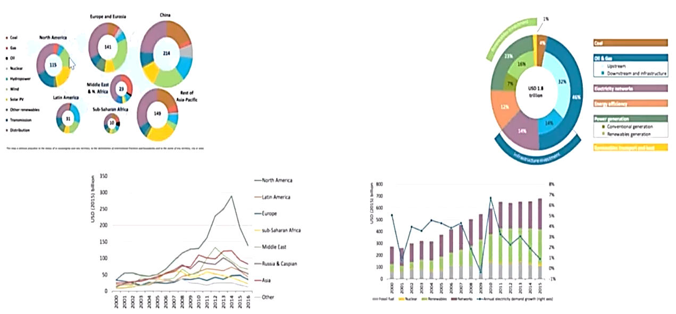
Other Countries & Energy Production

